Slide 1
DCENR – Electricity Network Codes Update 2015
Roinn Cumarsáide, Fuinnimh agus Acmhainní Nádúrtha
Department of Communications, Energy & Natural Resources
10 March 2015

Slide 2
Progress – 2014
EC optimistic prediction in January 2014:
  9 Committee meetings – 3 preparatory and 6 formal
  To discuss CACM, RfG, DCC and other Network Codes
  With a view to finalising CACM, RfG and DCC (at least) before June 2014

Slide 3
Detailed Progress – S1 2014
What actually happened?
  Two informal meetings in January and March and no codes finalised
  Announcement at Florence Forum:
    “The Forum urges the Commission to submit the Regulation on CACM into the Comitology procedure as soon as possible and takes note that the Commission will propose to adopt the CACM Regulation as binding Guidelines in the Comitology procedure. It welcomes the involvement of stakeholders in the implementation process and invites the Commission to involve stakeholders also in future amendments of the Regulation.”

Slide 4
Detailed Progress: S2 2014
Four Comitology meetings held in Brussels to discuss and finalise CACM text (September, October, November, December)
Text finally agreed on 5 December 2014. CZ, SK, BU voted against, all other MS voted in favour)
Key issue for IE was to secure delay in application of CACM until 31 December 2017 (with the exception of articles 4, 5, 6 – NEMO designation and functions)

Slide 5
What happens to CACM?
Text has been issued in official translation and will be sent to European Parliament and Council for scrutiny
Assuming EP and Council do not oppose the measure within three months, CACM is adopted by EC
Only grounds for opposition are:
  EC exceeds implementing powers provided for in basic legal act;
  The Regulation is not compatible with aim or content of the basic legal act;
  The Regulation does not respect the principles of subsidiarity or proportionality.

Slide 6
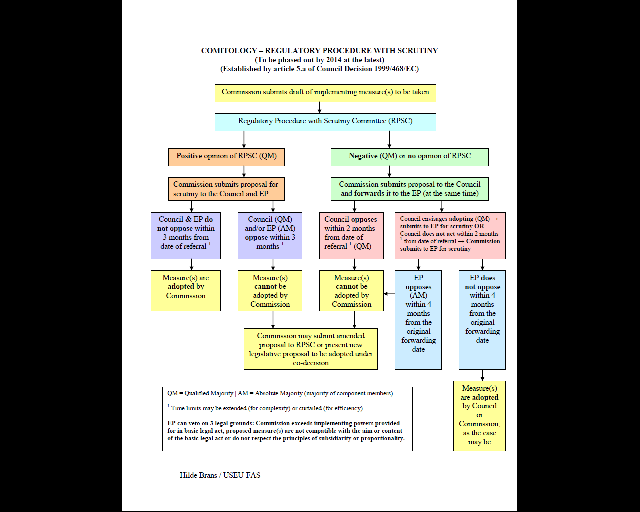
Comitology - PRAC

Slide 7
Comitology – 2015
One meeting on 04 February – RfG
Next meeting is in April – to discuss RfG, DCC, HVDC
EC hopes to finalise these codes by July
From July to December it aims to complete negotiation on OS, OPS, LFCR

Slide 8

Questions?

